Slide 1
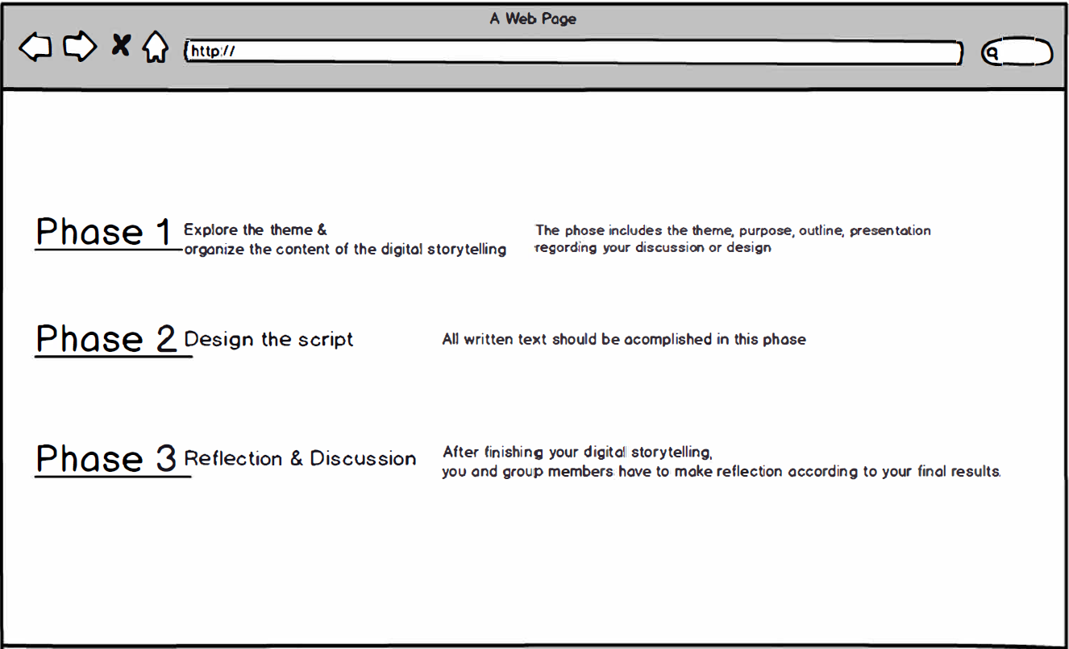

Slide 2
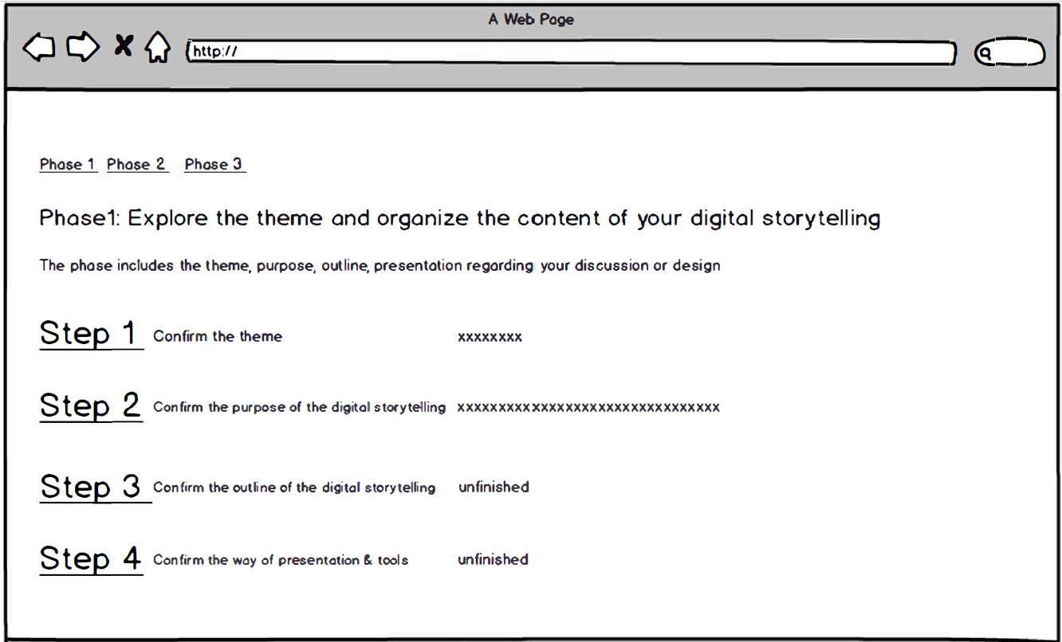
Pop-up or static window
Prompts → metacognition (direction maintain)
Learning objectives
Step 1: Theme
What’s the story you want to tell?
What do you think your story means?
Is the theme related to the educational theory?
❹ --
--
Purpose
Outline
Means & tools

Slide 3
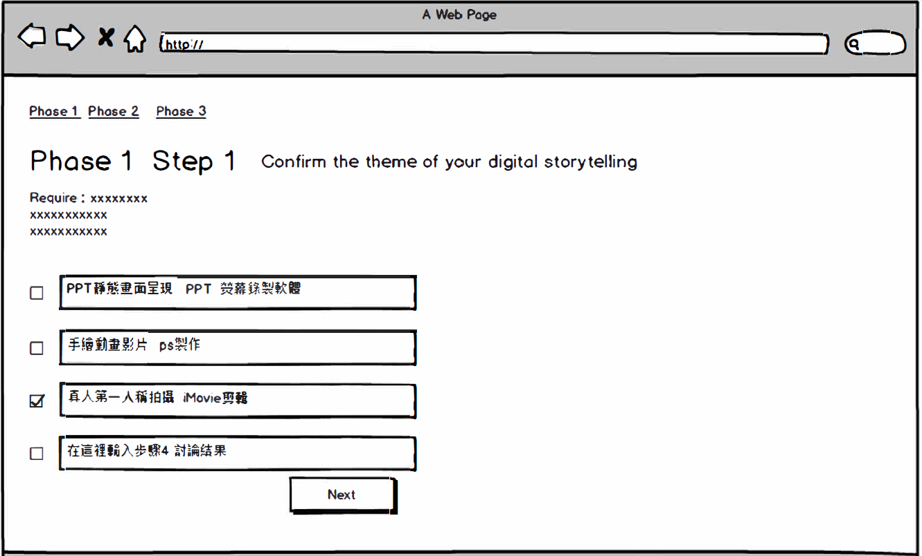

Slide 4
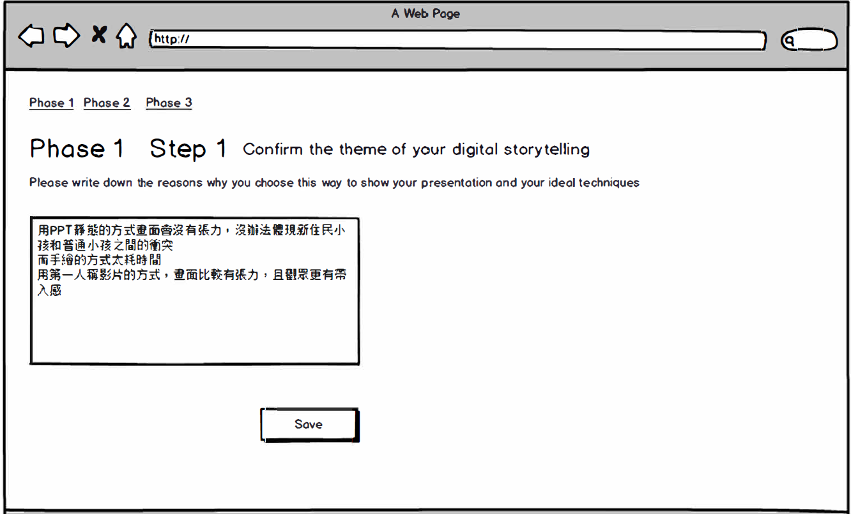

Slide 5
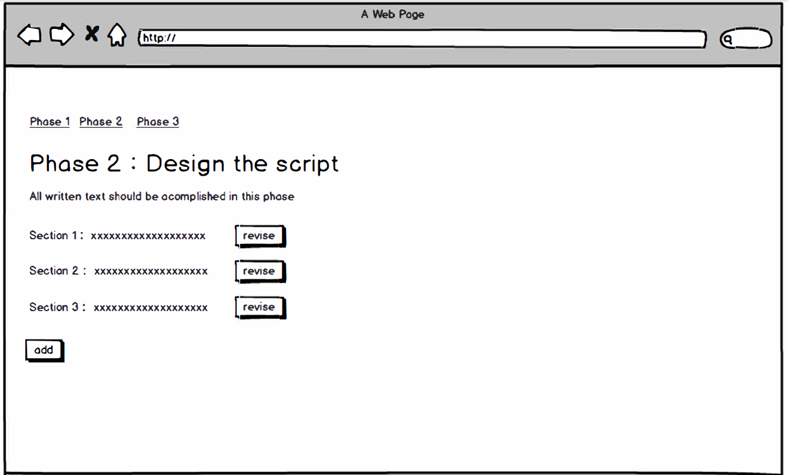

Slide 6
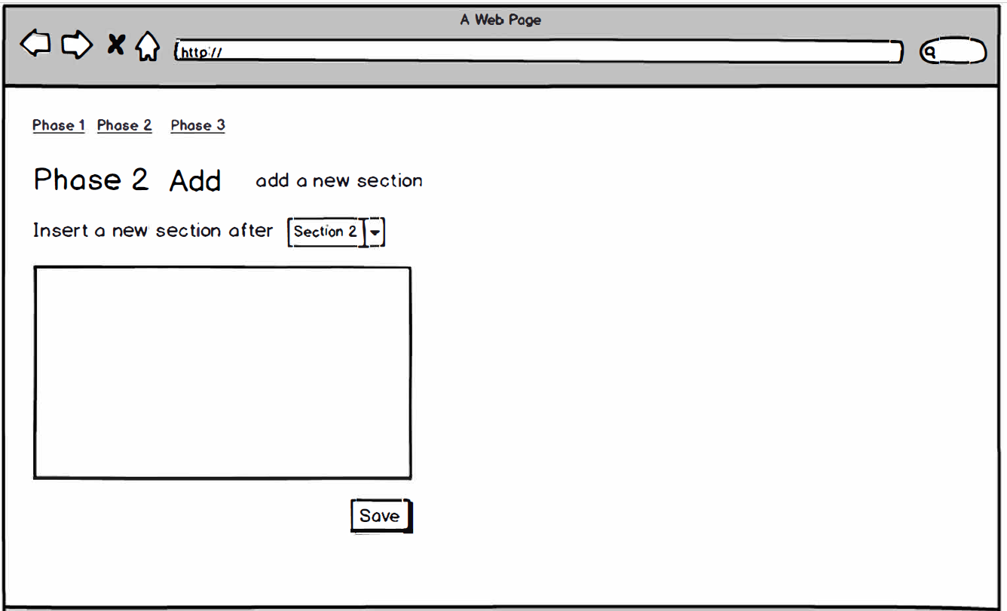

Slide 7
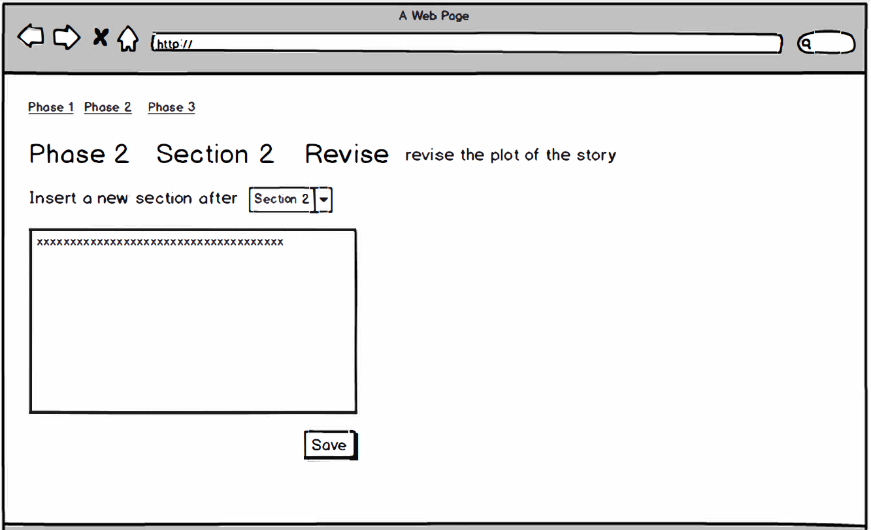

Slide 8
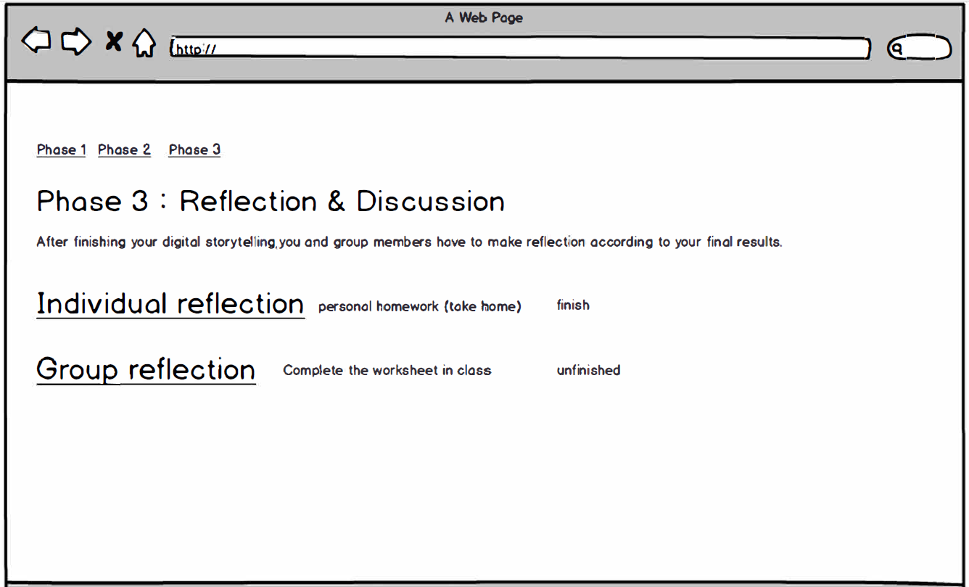

Slide 9
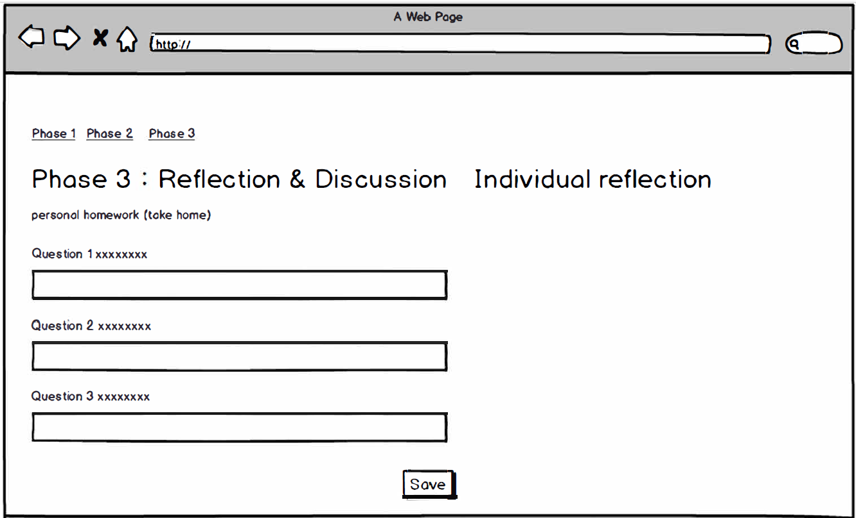

Slide 10
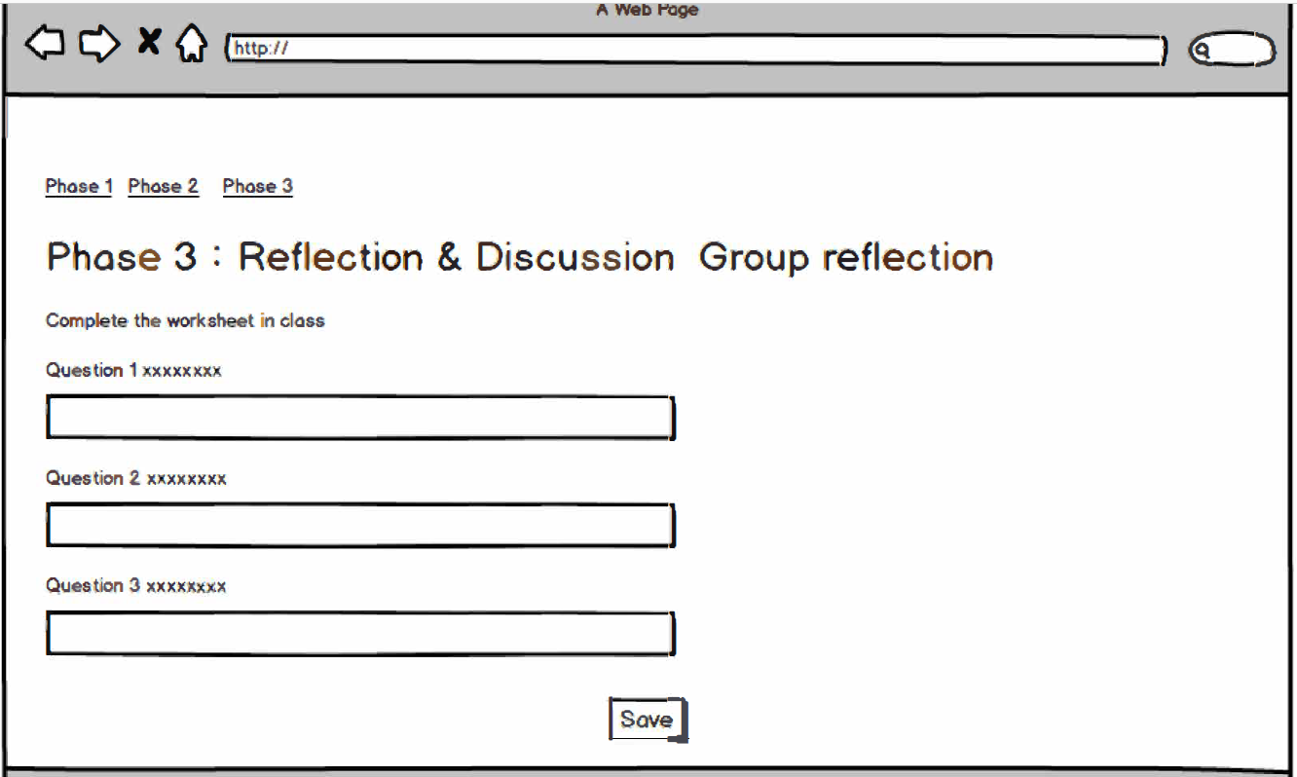
Flipped classroom 1 ❶❷❸
Flipped classroom 2 ❶❷❸
Presentation ❶❷❸

Slide 11
Personal reflection
Ask students to reflect on
❶ each step after finish it
❷ peer feedback then improve their story
their own stories about the concepts or theory of the story that we teach and discuss in class
❹ the process of making it with the teamwork
Group reflection
Ask group members to reflect on
❶ the process of making it with the teamwork

Slide 12
Phase 3: Personal reflection & Group reflection
Flipped classroom 1
First week:
→ Please carry out your reflection on current stage of making your story (theme and purpose)
Second week:
→ Please carry out your reflection on current stage of making your story (outline and rough draft)
Third week:
Peer feedback
Peer feedback
Teacher and researcher
My reflection:

Slide 13
Phase 3: Personal reflection & Group reflection
Group reflection
---------------:
→
❷ ---------------------:
→
-----------------:
→

Slide 14
問題
學生修改過後 資料會留在後台嗎?
資料會被覆蓋嗎?
能顯示出每一組做的東西嗎
學生該如何登入
http://tmof.ntust.edu.tw/2019cscl/login.php
當初Tmof系統是已經幫我們自動組好小組
所以如果讓同儕在家給回饋的話 就無法執行反思
變成要在課堂手寫

